Slide 1

Human Resource Management System
Name : Shubham Shivaji More
Roll no. : 221080047
Programme : IT
Semester : IV
Mobile no. : 8208644820
Email : ssmore_b22@it.vjti.ac.in
Subject:Database Management System
Guided By- Prof.V.B.Nikam
User details of the System-This can typically be used by various stakeholders within an organization or system.

Slide 2

Problem Statement
The Human Resources Management System (HRMS) project is a sophisticated software solution meticulously designed to address the myriad complexities and challenges of modern HR management within organizations. Built upon a robust and scalable database management system (DBMS), this project aims to revolutionize HR operations by seamlessly integrating advanced functionalities to streamline processes, enhance efficiency, and empower HR professionals with actionable insights. Moreover, the HRMS features automated modules for attendance tracking and leave management, leveraging real-time data capture mechanisms to accurately record employee work hours, absences, and leave requests. By automating these traditionally manual processes, the system not only eliminates the risk of errors but also enhances transparency and compliance with organizational policies and regulations. One of the standout features of the HRMS project is its sophisticated payroll processing module, which orchestrates the complex task of salary calculation, tax deductions, and bonus allocation with precision and efficiency. By adhering to predefined payroll rules and regulations, the system ensures accurate and timely compensation for employees, thereby fostering trust and satisfaction within the workforce. Furthermore, the HRMS project encompasses robust tools for performance evaluation and talent management, enabling HR professionals to conduct comprehensive performance appraisals, set goals, and identify training needs. With built-in analytics capabilities, the system provides actionable insights into workforce productivity, skill gaps, and talent retention strategies, empowering organizations to make data-driven decisions and optimize their human capital investments. In addition to its core functionalities, the HRMS project offers a comprehensive suite of recruitment and onboarding tools, facilitating the seamless integration of new hires into the organization. From job postings and applicant tracking to onboarding workflows and induction programs, the system streamlines the entire

Slide 3

recruitment lifecycle, enabling HR teams to attract top talent and nurture a culture of excellence. Lastly, the HRMS project includes an intuitive self-service portal for employees, granting them access to personal data, pay statements, leave balances, and
performance reviews. By empowering employees with self-service capabilities, the system promotes transparency, autonomy, and engagement, while reducing the administrative burden on HR personnel. Expected features of the Human Resources Management System (HRMS), including attendance management and other key functionalities, listed in points: ● Employee Information Management: Store and manage comprehensive employee profiles, including personal details, contact information, employment history, and qualifications. Maintain records of employee roles, departments, positions, and reporting structures within the organization. ● Attendance Management: Capture and track employee attendance data, including clock-in/out times, work hours, overtime hours, and absences. Utilize automated attendance tracking mechanisms such as biometric systems, RFID cards, or online timesheets for accurate data collection. ● Leave Management: Enable employees to request various types of leave (e.g., vacation, sick leave, maternity leave) through the system. Allow managers or HR personnel to review, approve, or deny leave requests based on company policies and leave balances. ● Payroll Processing: Automate payroll calculations, including salary disbursements, tax deductions, allowances, bonuses, and deductions. Generate pay stubs, salary statements, and tax documents for employees in compliance with legal and regulatory requirements. ● Performance Management: Conduct regular performance evaluations and assessments for employees using predefined criteria, KPIs, and performance indicators. Set performance goals, provide feedback, and track progress towards objectives through performance management tools. ● Training and Development: Manage employee training programs, workshops, certifications, and skill development initiatives. Track employee participation in training activities, monitor completion rates, and

Slide 4
assess the effectiveness of training programs. ● Recruitment and Onboarding: Post job vacancies, manage job postings, and track applications through an integrated recruitment module. Facilitate the onboarding process for new hires, including document collection, orientation sessions, and training assignments.
● Employee Self-Service Portal: Provide employees with secure access to their personal data, including pay statements, leave balances, and performance reviews. Allow employees to update their contact information, view company policies, and submit requests or inquiries through the self-service portal. ● Reporting and Analytics: Generate customizable reports and dashboards on HR metrics such as employee turnover, attendance trends, performance ratings, and training effectiveness. Utilize data analytics tools to gain insights into workforce demographics, skills gaps, succession planning, and talent retention strategies.
In summary, the HRMS project represents a paradigm shift in HR management, offering a comprehensive suite of tools and functionalities to optimize workforce management, drive organizational performance, and propel businesses towards sustained success in the digital age.

Slide 5
ER Model
● Entities and Attributes:
1. Employee 2. Department 3. Leave 4. Attendance 5. Payroll 6. PerformanceReview 7. Training 8. Recruitment
● Relationships Among Entities:
1. Employee and Department: One-to-Many (One department can have many employees) 2. Employee and Leave: One-to-Many (One employee can have multiple leave records) 3. Employee and Attendance: One-to-Many (One employee can have multiple attendance records) 4. Employee and Payroll: One-to-Many (One employee can have multiple payroll records) 5. Employee and PerformanceReview: One-to-Many (One employee can have multiple performance reviews) 6. Employee and Training: One-to-Many (One employee can participate in multiple training sessions) 7. Department and Recruitment: One-to-Many (One department can have multiple job openings)
● ER Diagram:

Slide 6
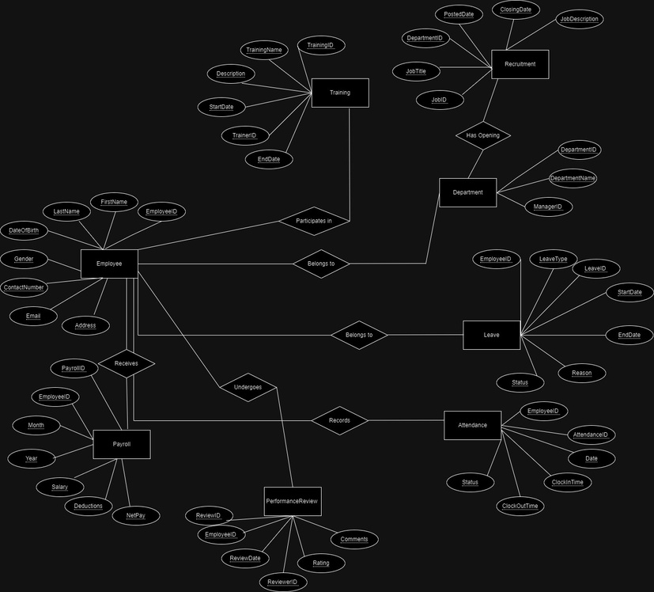

Slide 7
Schema Design
● Logical Schema:
Employee (EmployeeID, FirstName, LastName, DateOfBirth, Gender, ContactNumber, Email, Address)
Primary Key: EmployeeID
Department (DepartmentID, DepartmentName, ManagerID) Primary Key: DepartmentID Foreign Key: ManagerID (references EmployeeID in Employee table)
Leave (LeaveID, EmployeeID, LeaveType, StartDate, EndDate, Reason, Status) Primary Key: LeaveID Foreign Key: EmployeeID (references EmployeeID in Employee table) Attendance (AttendanceID, EmployeeID, Date, ClockInTime, ClockOutTime, Status) Primary Key: AttendanceID Foreign Key: EmployeeID (references EmployeeID in Employee table) Payroll (PayrollID, EmployeeID, Month, Year, Salary, Deductions, NetPay) Primary Key: PayrollID Foreign Key: EmployeeID (references EmployeeID in Employee table) PerformanceReview (ReviewID, EmployeeID, ReviewDate, ReviewerID, Rating, Comments) Primary Key: ReviewID Foreign Keys: EmployeeID (references EmployeeID in Employee table), ReviewerID (references EmployeeID in Employee table)

Slide 8
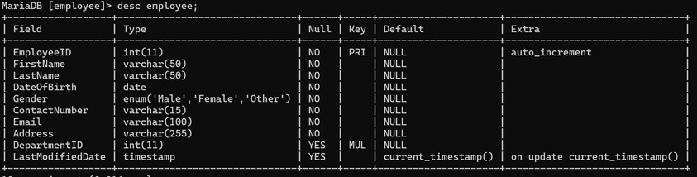
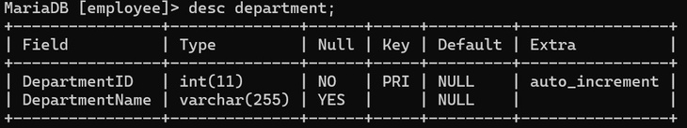
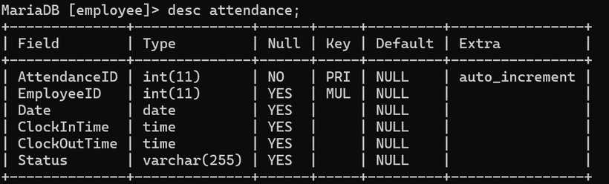
Training (TrainingID, TrainingName, Description, StartDate, EndDate, TrainerID) Primary Key: TrainingID Foreign Key: TrainerID (references EmployeeID in Employee table) Recruitment (JobID, JobTitle, DepartmentID, PostedDate, ClosingDate, JobDescription) Primary Key: JobID Foreign Key: DepartmentID (references DepartmentID in Department table)
Data Dictionary for the Schema
Employee Table-
Department Table-
Attendance Table-

Slide 9
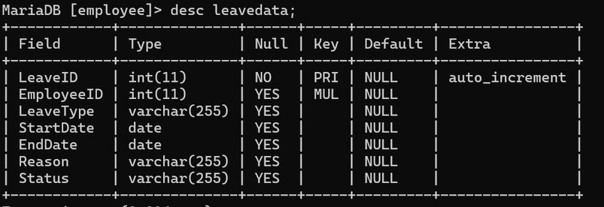
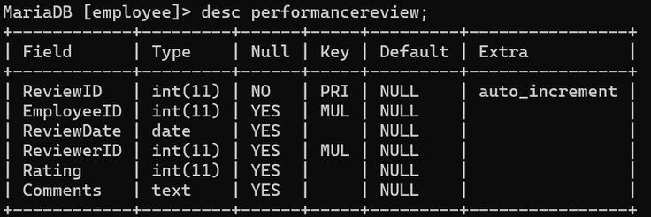
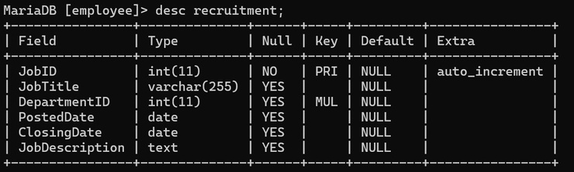
Leavedata Table-
Performance review Table-
RecruitmentTable-

Slide 10
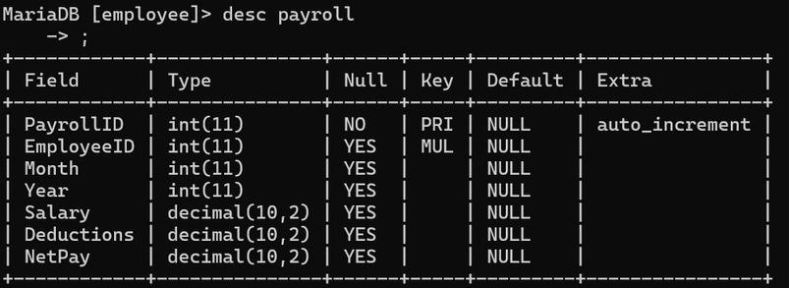
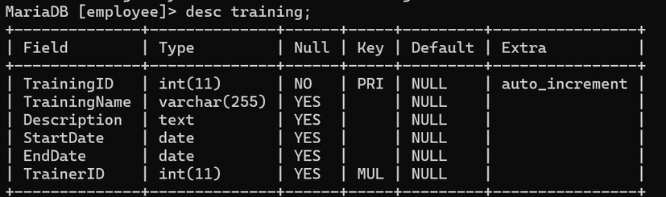
Payroll Table-
Training Table-
DDL for Data dictionary
(i) Employee:
CREATE TABLE Employee ( EmployeeID INT AUTO_INCREMENT PRIMARY KEY, FirstName VARCHAR(50) NOT NULL, LastName VARCHAR(50) NOT NULL,

Slide 11
DateOfBirth DATE NOT NULL, Gender ENUM('Male', 'Female', 'Other') NOT NULL, ContactNumberVARCHAR(15)NOTNULL, Email VARCHAR(100) NOT NULL, Address VARCHAR(255) NOT NULL );
ALTER TABLE Employee ADD COLUMN DepartmentID INT, ADD CONSTRAINT fk_department FOREIGN KEY (DepartmentID) REFERENCES Department(DepartmentID);
(ii) Department:
CREATE TABLE Department ( DepartmentID INT AUTO_INCREMENT PRIMARY KEY, DepartmentName VARCHAR(255) );
(iii) LeaveData:
CREATE TABLE LeaveData ( LeaveID INT AUTO_INCREMENT PRIMARY KEY, EmployeeID INT, LeaveType VARCHAR(255), StartDate DATE, EndDate DATE, Reason VARCHAR(255), Status VARCHAR(255), FOREIGN KEY (EmployeeID) REFERENCES Employee(EmployeeID) );
(iv) Attendance:
CREATE TABLE Attendance ( AttendanceID INT AUTO_INCREMENT PRIMARY KEY,
EmployeeID INT, DateDATE, ClockInTime TIME,

Slide 12
ClockOutTime TIME, Status VARCHAR(255), FOREIGN KEY (EmployeeID) REFERENCES Employee(EmployeeID) );
(v) Payroll:
CREATE TABLE Payroll ( PayrollID INT AUTO_INCREMENT PRIMARY KEY, EmployeeID INT, Month INT, YearINT, Salary DECIMAL(10, 2), Deductions DECIMAL(10, 2), NetPay DECIMAL(10, 2), FOREIGN KEY (EmployeeID) REFERENCES Employee(EmployeeID) );
(vi) PerformanceReview:
CREATE TABLE PerformanceReview ( ReviewID INT AUTO_INCREMENT PRIMARY KEY, EmployeeID INT, ReviewDateDATE, ReviewerID INT, Rating INT, Comments TEXT, FOREIGN KEY (EmployeeID) REFERENCES Employee(EmployeeID), FOREIGN KEY (ReviewerID) REFERENCES Employee(EmployeeID) );
(vii) Training:
CREATE TABLE Training ( TrainingID INT AUTO_INCREMENT PRIMARY KEY, TrainingName VARCHAR(255), Description TEXT, StartDate DATE, EndDate DATE, TrainerID INT,

Slide 13
FOREIGN KEY (TrainerID) REFERENCES Employee(EmployeeID) );
(viii) Recruitment:
CREATE TABLE Recruitment ( JobID INT AUTO_INCREMENT PRIMARY KEY, JobTitle VARCHAR(255), DepartmentID INT, PostedDateDATE, ClosingDate DATE, JobDescription TEXT, FOREIGN KEY (DepartmentID) REFERENCES Department(DepartmentID) );
SQL-DML to manipulate data for your ER Data Model
SQL-DML (Data Manipulation Language) is used to manipulate data stored in the database. It includes commands like `SELECT`, `INSERT`, `UPDATE`, `DELETE`, etc.
* `SELECT`: Retrieves data from one or more tables based on specified criteria. * `INSERT`: Adds new rows of data into a table. * `UPDATE`: Modifies existing data in a table. * `DELETE`: Removes rows of data from a table.
These commands allow you to interact with the data stored in your database, enabling you to perform tasks such as adding new records, updating existing ones, and removing unnecessary data.
(i)SQL-DML Exploring Complex Queries, Aggregate Functions, etc.: Complex Queries: Complex queries involve multiple conditions, joins, subqueries, and logical operators to retrieve specific data subsets from one or more tables.
Aggregate Functions: Aggregate functions operate on a set of values and return a single value summarizing the data. Examples include `AVG`, `SUM`, `COUNT`, `MIN`, and `MAX`. They are often used in conjunction with the `GROUP BY` clause

Slide 14
to perform calculations on grouped data.
Grouping and Sorting: The `GROUP BY` clause is used to group rows that have the same values into summary rows. It is often used with aggregate functions to calculate statistics for each group. Sorting can be achieved using the `ORDER BY` clause, which sorts the result set based on specified columns and directions (ascending or descending).
/* 1. Calculate average salary for each department */ SELECT DepartmentID, DepartmentName,
(SELECT AVG(Salary) FROM Payroll WHERE Employee.DepartmentID = Payroll.DepartmentID) AS AvgSalary FROM Department;
/* 2. Count the number of employees in each department */ SELECT DepartmentID, DepartmentName, (SELECT COUNT(*) FROM Employee WHERE Department.DepartmentID = Employee.DepartmentID) AS NumEmployees FROM Department;
/* 3. List employees with their total deductions, sorted by deduction amount */ SELECT EmployeeID, FirstName, LastName, (SELECT SUM(Deductions) FROM Payroll WHERE Employee.EmployeeID = Payroll.EmployeeID) AS TotalDeductions FROM Employee ORDER BY TotalDeductions DESC;
/* 4. Calculate the average performance rating for each employee */ SELECT EmployeeID, FirstName, LastName, (SELECT AVG(Rating) FROM PerformanceReview WHERE Employee.EmployeeID = PerformanceReview.EmployeeID) AS AvgRating FROM Employee;
/* 5. List the number of leave types taken by each employee */ SELECT EmployeeID, FirstName, LastName, (SELECT COUNT(LeaveType) FROM Leave WHERE Employee.EmployeeID = Leave.EmployeeID) AS NumLeaveTypes

Slide 15
FROM Employee;
/* 6. Calculate the total net pay for each month and year */ SELECT YEAR(Month), MONTH(Month), (SELECT SUM(NetPay) FROM Payroll WHERE MONTH(Payroll.Month) = MONTH(Month) AND YEAR(Payroll.Month) = YEAR(Month)) AS TotalNetPay FROM Payroll GROUP BY YEAR(Month), MONTH(Month);
/* 7. List employees with their total training hours, sorted by training hours */ SELECT EmployeeID, FirstName, LastName, (SELECT SUM(DurationHours) FROM TrainingAttendance INNER JOIN Training ON TrainingAttendance.TrainingID = Training.TrainingID WHERE Employee.EmployeeID = TrainingAttendance.EmployeeID) AS TotalTrainingHours FROM Employee ORDER BY TotalTrainingHours DESC;
/* 8. Count the number of performance reviews conducted by each employee */ SELECT EmployeeID, FirstName, LastName, (SELECT COUNT(ReviewID) FROM PerformanceReview WHERE Employee.EmployeeID = PerformanceReview.ReviewerID) AS NumReviews FROM Employee;
/* 9. Calculate the average salary for employees in each job title */ SELECT JobTitle, (SELECT AVG(Salary) FROM Payroll WHERE Employee.JobTitle = Payroll.JobTitle) AS AvgSalary FROM Employee
GROUP BY JobTitle;
/* 10. List employees with their highest performance rating */ SELECT EmployeeID, FirstName, LastName, (SELECT MAX(Rating) FROM PerformanceReview WHERE Employee.EmployeeID = PerformanceReview.EmployeeID) AS MaxRating FROM Employee;

Slide 16
/* 11. Search for an employee by EmployeeID */ SELECT * FROM Employee WHERE EmployeeID = 5;
/* 12. Search for employees with a specific job title */ SELECT * FROM Employee WHERE JobTitle = 'Software Engineer';
/* 13. Delete an employee with EmployeeID 10 */ DELETE FROM Employee WHERE EmployeeID = 10;
/* 14. Update the salary of an employee with EmployeeID 15 */ UPDATE Payroll SET Salary = 90000 WHERE EmployeeID = 15; /* 15. Insert a new employee */ INSERT INTO Employee (FirstName, LastName, JobTitle, DepartmentID) VALUES ('A', 'B', 'Data Analyst', 3);
(ii)SQL-DML Exploring Nested Queries and Join Queries:
Nested Queries:
Nested queries, also known as subqueries, are queries within another query. They are useful for performing operations that require data from multiple tables or complex filtering conditions.
Join Queries: Join queries combine data from two or more tables based on a related column between them. Common types of joins include `INNER JOIN`, `LEFT JOIN`, `RIGHT JOIN`, and `FULL JOIN`. They allow you to retrieve data from multiple tables simultaneously, correlating rows based on specified join conditions.
/* 1. Find employees who have salaries greater than the average salary */ SELECT * FROM Employee WHERE Salary > (SELECT AVG(Salary) FROM Payroll);
/* 2. Find employees who have attended training sessions with specific trainers */ SELECT * FROM Employee WHERE EmployeeID IN (SELECT TrainerID FROM Training WHERE TrainingName = 'Leadership Development');

Slide 17
/* 3. Find employees who have taken sick leave */ SELECT * FROM Employee WHERE EmployeeID IN (SELECT EmployeeID FROM Leave WHERE LeaveType = 'Sick Leave');
/* 4. Find employees who have not taken any vacation */ SELECT * FROM Employee
WHERE EmployeeID NOT IN (SELECT EmployeeID FROM Leave WHERE LeaveType = 'Vacation');
/* 5. Find employees who have attended training sessions and also taken leave */ SELECT * FROM Employee WHERE EmployeeID IN (SELECT EmployeeID FROM Training) AND EmployeeID IN (SELECT EmployeeID FROM Leave);
/* 6. Find employees who have not been reviewed yet */ SELECT * FROM Employee WHERE EmployeeID NOT IN (SELECT EmployeeID FROM PerformanceReview);
/* 7. Find employees who have the highest rating in their performance reviews */ SELECT EmployeeID, MAX(Rating) AS HighestRating FROM PerformanceReview GROUP BY EmployeeID;
/* 8. Find the average net pay for each department */ SELECT d.DepartmentName, AVG(p.NetPay) AS AverageNetPay FROM Department d JOIN Employee e ON d.DepartmentID = e.DepartmentID JOIN Payroll p ON e.EmployeeID = p.EmployeeID GROUP BY d.DepartmentName;
/* 9. Find the total deductions for each month */ SELECT MONTH(StartDate) AS Month, SUM(Deductions) AS TotalDeductions
FROM Payroll GROUP BY MONTH(StartDate);

Slide 18
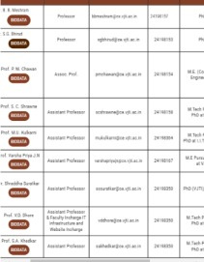
/* 10. Find employees who have taken leave during their probation period */ SELECT * FROM Employee WHERE EmployeeID IN (SELECT EmployeeID FROM Leave WHERE StartDate <= ProbationEndDate);
Data Collection-
Source
- vjti.ac.in
(VJTI OFFICIAL WEBSITE)
Write DML & DCL
/* 1. Retrieve all employees' details. */ SELECT * FROM Employee;
/*

Slide 19
2. Retrieve all departments and their managers. */ SELECT DepartmentName, FirstName, LastName FROM Department JOIN Employee ON Department.ManagerID = Employee.EmployeeID;
/* 3. List all employees who have taken leaves. */ SELECT DISTINCT EmployeeID, FirstName, LastName FROM Leave JOIN Employee ON Leave.EmployeeID = Employee.EmployeeID; /* 4. Count the total number of leaves taken by each employee. */ SELECT EmployeeID, FirstName, LastName, COUNT(*) AS TotalLeaves FROM Leave JOIN Employee ON Leave.EmployeeID = Employee.EmployeeID GROUP BY EmployeeID, FirstName, LastName; /* 5. Find the average attendance rate for all employees. */ SELECT AVG(CASE WHEN Status = 'present' THEN 1 ELSE 0 END) AS AverageAttendanceRate FROM Attendance;
/* 6. Retrieve the payroll details for a specific employee. */ SELECT * FROM Payroll WHERE EmployeeID = 1; /*
7. List all employees who have received a performance review. */ SELECT DISTINCT EmployeeID, FirstName, LastName FROM PerformanceReview

Slide 20
JOIN Employee ON PerformanceReview.EmployeeID = Employee.EmployeeID; /* 8. Find the highest-rated employee in the latest performance review. */ SELECT EmployeeID, FirstName, LastName, MAX(Rating) AS HighestRating FROM PerformanceReview JOIN Employee ON PerformanceReview.EmployeeID = Employee.EmployeeID WHERE ReviewDate = (SELECT MAX(ReviewDate) FROM PerformanceReview);
/* 9. Retrieve the details of all training sessions. */ SELECT * FROM Training; /* 10. List employees participating in a specific training session. */ SELECT EmployeeID, FirstName, LastName FROM Training
JOIN Employee ON Training.TrainerID = Employee.EmployeeID WHERE TrainingID = 1; /* 11. Retrieve all job openings in a particular department. */ SELECT JobTitle, JobDescription FROM Recruitment WHERE DepartmentID = 1;
/* 12. Count the number of job openings in each department. */ SELECT DepartmentName, COUNT(*) AS NumJobOpenings

Slide 21
FROM Recruitment JOIN Department ON Recruitment.DepartmentID = Department.DepartmentID GROUP BY DepartmentName; /* 13. Find the average salary of employees in each department. */ SELECT DepartmentName, AVG(Salary) AS AverageSalary FROM Payroll JOIN Employee ON Payroll.EmployeeID = Employee.EmployeeID JOIN Department ON Employee.DepartmentID = Department.DepartmentID GROUP BY DepartmentName;
/* 14. Retrieve the contact details of all employees. */ SELECT FirstName, LastName, ContactNumber, Email FROM Employee; /* 15. List employees sorted by their date of birth. */ SELECT * FROM Employee ORDER BY DateOfBirth;
/* 16. Count the number of male and female employees. */ SELECT Gender, COUNT(*) AS NumEmployees FROM Employee GROUP BY Gender; /* 17. Find the oldest employee in the company. */ SELECT * FROM Employee ORDER BY DateOfBirth LIMIT 1;
/* 18. List employees who have not taken any leave. */

Slide 22
SELECT EmployeeID, FirstName, LastName FROM Employee WHERE EmployeeID NOT IN (SELECT DISTINCT EmployeeID FROM Leave);
/* 19. Retrieve the total deductions for each employee from the payroll. */ SELECT EmployeeID, FirstName, LastName, SUM(Deductions) AS TotalDeductions FROM Payroll JOIN Employee ON Payroll.EmployeeID = Employee.EmployeeID GROUP BY EmployeeID, FirstName, LastName; /* 20. Find the employee with the highest net pay. */ SELECT EmployeeID, FirstName, LastName, MAX(NetPay) AS HighestNetPay FROM Payroll JOIN Employee ON Payroll.EmployeeID = Employee.EmployeeID;
/* 21. List employees with their corresponding department names. */ SELECT FirstName, LastName, DepartmentName FROM Employee JOIN Department ON Employee.DepartmentID = Department.DepartmentID; /* 22. Count the number of employees in each department. */
SELECT DepartmentName, COUNT(*) AS NumEmployees FROM Employee JOIN Department ON Employee.DepartmentID = Department.DepartmentID

Slide 23
GROUP BY DepartmentName; /* 23. Retrieve the job title and department name of each job opening. */ SELECT JobTitle, DepartmentName FROM Recruitment JOIN Department ON Recruitment.DepartmentID = Department.DepartmentID; /* 24. List employees with their attendance records for a specific date. */ SELECT EmployeeID, FirstName, LastName, Date, ClockInTime, ClockOutTime, Status FROM Attendance JOIN Employee ON Attendance.EmployeeID = Employee.EmployeeID WHERE Date = '2024-04-05';
/* 25. Find the total salary expenditure for the company. */ SELECT SUM(Salary) AS TotalSalaryExpenditure FROM Payroll;
/* 26. Retrieve the details of employees who have received a specific rating in their performance review. */ SELECT EmployeeID, FirstName, LastName FROM PerformanceReview JOIN Employee ON PerformanceReview.EmployeeID = Employee.EmployeeID WHERE Rating = 5; /* 27. Count the number of employees who have attended each training session. */ SELECT TrainingID, TrainingName, COUNT(EmployeeID) AS

Slide 24
NumParticipants FROM Training GROUP BY TrainingID, TrainingName; /* 28. Find the total number of job openings posted in a specific month. */ SELECT COUNT(*) AS NumJobOpenings FROM Recruitment WHERE MONTH(PostedDate) = 4 AND YEAR(PostedDate) = 2024; /* 29. List employees who have the same contact number. */ SELECT ContactNumber, COUNT(*) AS NumEmployees FROM Employee
GROUP BY ContactNumber HAVING COUNT(*) > 1; /* 30. Retrieve the details of employees whose last name starts with a specific letter. */ SELECT * FROM Employee WHERE LastName LIKE 'S%'; /* 31. Find the highest-rated training session. */ SELECT TrainingID, TrainingName, MAX(Rating) AS HighestRating FROM PerformanceReview JOIN Training ON PerformanceReview.TrainingID = Training.TrainingID; /* 32. Retrieve the email addresses of employees who have taken leaves in the last month. */ SELECT DISTINCT Email FROM Leave JOIN Employee ON Leave.EmployeeID = Employee.EmployeeID WHERE StartDate BETWEEN '2024-03-01' AND '2024-03-31'; /*

Slide 25
33. Count the number of employees who have a specific email domain. */
SELECT SUBSTRING_INDEX(Email, '@', -1) AS EmailDomain, COUNT(*) AS NumEmployees FROM Employee GROUP BY EmailDomain;
/* 34. Find the employees who have not attended any training sessions. */ SELECT EmployeeID, FirstName, LastName FROM Employee WHERE EmployeeID NOT IN (SELECT DISTINCT EmployeeID FROM Training); /* 35. Retrieve the details of employees who were hired in a specific year. */ SELECT * FROM Employee WHERE YEAR(DateOfBirth) = 1990;
/* 36. Find the average duration of leaves taken by employees. */ SELECT AVG(DATEDIFF(EndDate, StartDate)) AS AverageLeaveDuration FROM Leave;
/* 37. List employees with their clock-in and clock-out times for a specific date. */
SELECT EmployeeID, FirstName, LastName, ClockInTime, ClockOutTime FROM Attendance JOIN Employee ON Attendance.EmployeeID =

Slide 26
Employee.EmployeeID WHERE Date = '2024-04-05'; /* 38. Retrieve the details of employees who have not received a performance review. */ SELECT * FROM Employee WHERE EmployeeID NOT IN (SELECT DISTINCT EmployeeID FROM PerformanceReview); /* 39. Count the number of employees who have taken sick leaves. */ SELECT COUNT(*) AS NumEmployees FROM Leave WHERE LeaveType = 'Sick Leave'; /* 40. Find the department with the highest number of job openings. */ SELECT DepartmentName, COUNT(*) AS NumJobOpenings FROM Recruitment JOIN Department ON Recruitment.DepartmentID = Department.DepartmentID GROUP BY DepartmentName ORDER BY COUNT(*) DESC
LIMIT 1;
/* 41. Retrieve the details of employees who have been absent without notice. */ SELECT EmployeeID, FirstName, LastName FROM Attendance JOIN Employee ON Attendance.EmployeeID = Employee.EmployeeID WHERE Status = 'Absent Without Notice';
/* 42. List employees who have attended training sessions

Slide 27
conducted by a specific trainer. */ SELECT EmployeeID, FirstName, LastName FROM Training JOIN Employee ON Training.TrainerID = Employee.EmployeeID WHERE TrainerID = 1;
/* 43. Count the number of employees who have taken leaves due to personal reasons. */ SELECT COUNT(*) AS NumEmployees FROM Leave WHERE Reason = 'Personal';
/*
44. Find the average duration of attendance for each employee. */ SELECT EmployeeID, AVG(TIMEDIFF(ClockOutTime, ClockInTime)) AS AverageAttendanceDuration FROM Attendance GROUP BY EmployeeID; /* 45. Retrieve the details of employees who have taken a leave longer than a specific duration. */ SELECT EmployeeID, FirstName, LastName, DATEDIFF(EndDate, StartDate) AS LeaveDuration FROM Leave JOIN Employee ON Leave.EmployeeID = Employee.EmployeeID WHERE DATEDIFF(EndDate, StartDate) > 7; /* 46. List employees who have participated in training sessions held in a specific month. */ SELECT DISTINCT EmployeeID, FirstName, LastName FROM Training

Slide 28
JOIN Employee ON Training.EmployeeID = Employee.EmployeeID WHERE MONTH(StartDate) = 4 AND YEAR(StartDate) = 2024; /* 47. Retrieve the details of employees who have not attended work for a specific duration. */
SELECT EmployeeID, FirstName, LastName FROM Attendance JOIN Employee ON Attendance.EmployeeID = Employee.EmployeeID GROUP BY EmployeeID HAVING SUM(IF(Status = 'Absent', 1, 0)) > 3; /* 48. List employees with their salary details sorted by department. */ SELECT FirstName, LastName, DepartmentName, Salary, Deductions, NetPay FROM Employee JOIN Payroll ON Employee.EmployeeID = Payroll.EmployeeID JOIN Department ON Employee.DepartmentID = Department.DepartmentID ORDER BY DepartmentName; /* 49. Count the number of employees who have received a rating above a certain threshold in their performance review. */ SELECT COUNT(*) AS NumEmployees FROM PerformanceReview WHERE Rating > 4; /* 50. Find the total number of leaves taken by employees in each department. */
SELECT DepartmentName, COUNT(*) AS NumLeaves FROM Leave

Slide 29
JOIN Employee ON Leave.EmployeeID = Employee.EmployeeID JOIN Department ON Employee.DepartmentID = Department.DepartmentID GROUP BY DepartmentName; /* 51. Retrieve the details of employees who have taken leaves in the last week. */ SELECT EmployeeID, FirstName, LastName FROM Leave JOIN Employee ON Leave.EmployeeID = Employee.EmployeeID WHERE StartDate BETWEEN DATE_SUB(CURDATE(), INTERVAL 7 DAY) AND CURDATE(); /* 52. List employees who have been absent for more than three days consecutively. */ SELECT DISTINCT EmployeeID, FirstName, LastName FROM Attendance AS a1 JOIN Attendance AS a2 ON a1.EmployeeID = a2.EmployeeID WHERE DATEDIFF(a2.Date, a1.Date) = 1 AND a1.Status = 'Absent' AND a2.Status = 'Absent'; /* 53. Retrieve the details of employees who have not received any deductions in their payroll. */ SELECT EmployeeID, FirstName, LastName
FROM Payroll JOIN Employee ON Payroll.EmployeeID = Employee.EmployeeID WHERE Deductions = 0;
/* 54. Count the number of employees who have participated in more than five training sessions. */ SELECT EmployeeID, COUNT(*) AS NumTrainingSessions FROM Training GROUP BY EmployeeID

Slide 30
HAVING COUNT(*) > 5; /* 55. Find the department with the highest average salary. */ SELECT DepartmentName, AVG(Salary) AS AverageSalary FROM Payroll JOIN Employee ON Payroll.EmployeeID = Employee.EmployeeID JOIN Department ON Employee.DepartmentID = Department.DepartmentID GROUP BY DepartmentName ORDER BY AVG(Salary) DESC LIMIT 1; /* 56. Retrieve the details of employees who have not attended any training sessions in the last six months. */ SELECT EmployeeID, FirstName, LastName
FROM Employee WHERE EmployeeID NOT IN (SELECT DISTINCT EmployeeID FROM Training WHERE StartDate BETWEEN DATE_SUB(CURDATE(), INTERVAL 6 MONTH) AND CURDATE()); /* 57. List employees who have received a performance rating of 4 or above in the last quarter. */ SELECT DISTINCT EmployeeID, FirstName, LastName FROM PerformanceReview WHERE Rating >= 4 AND ReviewDate BETWEEN DATE_SUB(CURDATE(), INTERVAL 3 MONTH) AND CURDATE(); /* 58. Retrieve the details of employees who have taken leaves due to maternity reasons. */ SELECT EmployeeID, FirstName, LastName FROM Leave JOIN Employee ON Leave.EmployeeID = Employee.EmployeeID WHERE Reason = 'Maternity'; /*

Slide 31
59. Count the number of male employees who have received a performance rating above 3. */ SELECT COUNT(*) AS NumEmployees FROM PerformanceReview JOIN Employee ON PerformanceReview.EmployeeID = Employee.EmployeeID WHERE Gender = 'Male' AND Rating > 3;
/* 60. Find the department with the highest number of female employees. */ SELECT DepartmentName, COUNT(*) AS NumFemaleEmployees FROM Employee JOIN Department ON Employee.DepartmentID = Department.DepartmentID WHERE Gender = 'Female' GROUP BY DepartmentName ORDER BY COUNT(*) DESC LIMIT 1;
/* 61. Retrieve the details of employees who have not taken any leaves in the last six months. */ SELECT EmployeeID, FirstName, LastName FROM Employee WHERE EmployeeID NOT IN (SELECT DISTINCT EmployeeID FROM Leave WHERE StartDate BETWEEN DATE_SUB(CURDATE(), INTERVAL 6 MONTH) AND CURDATE());
/* 62. List employees who have attended training sessions conducted by themselves. */ SELECT DISTINCT e.EmployeeID, e.FirstName, e.LastName FROM Training AS t JOIN Employee AS e ON t.TrainerID = e.EmployeeID WHERE t.EmployeeID = e.EmployeeID;

Slide 32
/* 63. Retrieve the details of employees who have taken leaves longer than ten days for personal reasons. */ SELECT EmployeeID, FirstName, LastName FROM Leave JOIN Employee ON Leave.EmployeeID = Employee.EmployeeID WHERE Reason = 'Personal' AND DATEDIFF(EndDate, StartDate) > 10; /* 64. Count the number of employees who have received a performance rating of 5. */ SELECT COUNT(*) AS NumEmployees FROM PerformanceReview WHERE Rating = 5; /* 65. Find the total number of leaves taken by each employee in the last year. */ SELECT EmployeeID, FirstName, LastName FROM Leave JOIN Employee ON Leave.EmployeeID = Employee.EmployeeID WHERE StartDate BETWEEN DATE_SUB(CURDATE(), INTERVAL 1 YEAR) AND CURDATE(); /* 66. Retrieve the details of employees who have received a performance rating below 2.
*/ SELECT EmployeeID, FirstName, LastName FROM PerformanceReview JOIN Employee ON PerformanceReview.EmployeeID = Employee.EmployeeID WHERE Rating < 2; /* 67. List employees who have attended all training sessions. */

Slide 33
SELECT EmployeeID, FirstName, LastName FROM Employee WHERE EmployeeID NOT IN (SELECT EmployeeID FROM Training GROUP BY EmployeeID HAVING COUNT(*) < (SELECT COUNT(*) FROM Training)); /* 68. Retrieve the email addresses of employees who have taken sick leaves in the last month. */ SELECT DISTINCT Email FROM Leave JOIN Employee ON Leave.EmployeeID = Employee.EmployeeID WHERE LeaveType = 'Sick Leave' AND StartDate BETWEEN DATE_SUB(CURDATE(), INTERVAL 1 MONTH) AND CURDATE(); /* 69. Count the number of male employees in each department. */ SELECT DepartmentName, COUNT(*) AS NumMaleEmployees
FROM Employee JOIN Department ON Employee.DepartmentID = Department.DepartmentID WHERE Gender = 'Male' GROUP BY DepartmentName; /* 70. Find the average salary of male and female employees. */ SELECT Gender, AVG(Salary) AS AverageSalary FROM Employee JOIN Payroll ON Employee.EmployeeID = Payroll.EmployeeID GROUP BY Gender; /* 71. Retrieve the details of employees who have received a performance rating below 3 in the last quarter. */ SELECT EmployeeID, FirstName, LastName FROM PerformanceReview JOIN Employee ON PerformanceReview.EmployeeID =

Slide 34
Employee.EmployeeID WHERE Rating < 3 AND ReviewDate BETWEEN DATE_SUB(CURDATE(), INTERVAL 3 MONTH) AND CURDATE(); /* 72. List employees who have attended training sessions in a specific location. */ SELECT EmployeeID, FirstName, LastName FROM Training
JOIN Employee ON Training.TrainerID = Employee.EmployeeID WHERE Address = 'Specific Location'; /* 73. Retrieve the contact details of employees who have taken leaves due to family emergencies. */ SELECT ContactNumber, Email FROM Leave JOIN Employee ON Leave.EmployeeID = Employee.EmployeeID WHERE Reason = 'Family Emergency'; /* 74. Count the number of female employees who have received a performance rating above 4. */ SELECT COUNT(*) AS NumEmployees FROM PerformanceReview JOIN Employee ON PerformanceReview.EmployeeID = Employee.EmployeeID WHERE Gender = 'Female' AND Rating > 4; /* 75. Find the total number of leaves taken by each employee in the last month. */ SELECT EmployeeID, FirstName, LastName FROM Leave JOIN Employee ON Leave.EmployeeID = Employee.EmployeeID WHERE StartDate BETWEEN DATE_SUB(CURDATE(), INTERVAL 1 MONTH) AND CURDATE();

Slide 35
/* 76. Retrieve the details of employees who have received a performance rating of 3 in the last year. */ SELECT EmployeeID, FirstName, LastName FROM PerformanceReview JOIN Employee ON PerformanceReview.EmployeeID = Employee.EmployeeID WHERE Rating = 3 AND ReviewDate BETWEEN DATE_SUB(CURDATE(), INTERVAL 1 YEAR) AND CURDATE();
/* 77. List employees who have taken leaves due to medical reasons. */ SELECT EmployeeID, FirstName, LastName FROM Leave JOIN Employee ON Leave.EmployeeID = Employee.EmployeeID WHERE Reason = 'Medical';
/* 78. Retrieve the job title and department name of each job opening posted in the last six months. */ SELECT JobTitle, DepartmentName FROM Recruitment JOIN Department ON Recruitment.DepartmentID = Department.DepartmentID WHERE PostedDate BETWEEN DATE_SUB(CURDATE(), INTERVAL 6 MONTH) AND CURDATE();
/* 79. Count the number of employees who have not attended any training sessions in the last three months. */ SELECT COUNT(*) AS NumEmployees FROM Employee WHERE EmployeeID NOT IN (SELECT DISTINCT EmployeeID FROM Training WHERE StartDate BETWEEN DATE_SUB(CURDATE(), INTERVAL 3 MONTH) AND CURDATE());

Slide 36
/* 80. Find the department with the highest number of male employees. */ SELECT DepartmentName, COUNT(*) AS NumMaleEmployees FROM Employee JOIN Department ON Employee.DepartmentID = Department.DepartmentID WHERE Gender = 'Male' GROUP BY DepartmentName ORDER BY COUNT(*) DESC LIMIT 1; /* 81. Retrieve the details of employees who have received a performance rating above 4 in the last month. */ SELECT EmployeeID, FirstName, LastName FROM PerformanceReview JOIN Employee ON PerformanceReview.EmployeeID = Employee.EmployeeID
WHERE Rating > 4 AND ReviewDate BETWEEN DATE_SUB(CURDATE(), INTERVAL 1 MONTH) AND CURDATE(); /* 82. List employees who have not attended any training sessions conducted in a specific month. */ SELECT EmployeeID, FirstName, LastName FROM Employee WHERE EmployeeID NOT IN (SELECT DISTINCT EmployeeID FROM Training WHERE MONTH(StartDate) = 4 AND YEAR(StartDate) = 2024); /* 83. Retrieve the details of employees who have received a performance rating of 5 in the last six months. */ SELECT EmployeeID, FirstName, LastName FROM PerformanceReview JOIN Employee ON PerformanceReview.EmployeeID = Employee.EmployeeID

Slide 37
WHERE Rating = 5 AND ReviewDate BETWEEN DATE_SUB(CURDATE(), INTERVAL 6 MONTH) AND CURDATE();
/* 84. Count the number of employees who have received a performance rating above 3 in the last year. */ SELECT COUNT() AS NumEmployees FROM PerformanceReview WHERE Rating > 3 AND ReviewDate BETWEEN DATE_SUB(CURDATE(), INTERVAL 1 YEAR) AND CURDATE();
/* 85. Find the average salary of employees in each department. */ SELECT DepartmentName, AVG(Salary) AS AverageSalary FROM Payroll JOIN Employee ON Payroll.EmployeeID = Employee.EmployeeID JOIN Department ON Employee.DepartmentID = Department.DepartmentID GROUP BY DepartmentName; /* 86. Retrieve the details of employees who have not attended any training sessions conducted by male trainers. */ SELECT EmployeeID, FirstName, LastName FROM Employee WHERE EmployeeID NOT IN (SELECT EmployeeID FROM Training WHERE TrainerID IN (SELECT EmployeeID FROM Employee WHERE Gender = 'Male'));
/* 87. Count the number of female employees who have received a performance rating above 4 in the last quarter. */ SELECT COUNT() AS NumEmployees

Slide 38
FROM PerformanceReview
JOIN Employee ON PerformanceReview.EmployeeID = Employee.EmployeeID WHERE Gender = 'Female' AND Rating > 4 AND ReviewDate BETWEEN DATE_SUB(CURDATE(), INTERVAL 3 MONTH) AND CURDATE(); /* 88. Find the department with the highest number of employees. */ SELECT DepartmentName, COUNT() AS NumEmployees FROM Employee JOIN Department ON Employee.DepartmentID = Department.DepartmentID GROUP BY DepartmentName ORDER BY COUNT(*) DESC LIMIT 1;
/* 89. Retrieve the details of employees who have taken leaves in the last quarter. */ SELECT EmployeeID, FirstName, LastName FROM Leave JOIN Employee ON Leave.EmployeeID = Employee.EmployeeID WHERE StartDate BETWEEN DATE_SUB(CURDATE(), INTERVAL 3 MONTH) AND CURDATE(); /* 90. List employees who have participated in training sessions conducted in a specific month. */
SELECT EmployeeID, FirstName, LastName FROM Training JOIN Employee ON Training.EmployeeID = Employee.EmployeeID WHERE MONTH(StartDate) = 4 AND YEAR(StartDate) = 2024; /* 91. Retrieve the details of employees who have received

Slide 39
a performance rating of 5 in the last year. */ SELECT EmployeeID, FirstName, LastName FROM PerformanceReview JOIN Employee ON PerformanceReview.EmployeeID = Employee.EmployeeID WHERE Rating = 5 AND ReviewDate BETWEEN DATE_SUB(CURDATE(), INTERVAL 1 YEAR) AND CURDATE(); /* 92. Count the number of employees who have received a performance rating above 3 in the last month. */ SELECT COUNT() AS NumEmployees FROM PerformanceReview WHERE Rating > 3 AND ReviewDate BETWEEN DATE_SUB(CURDATE(), INTERVAL 1 MONTH) AND CURDATE(); /* 93. Find the average salary of employees in each department. */ SELECT DepartmentName, AVG(Salary) AS AverageSalary FROM Payroll
JOIN Employee ON Payroll.EmployeeID = Employee.EmployeeID JOIN Department ON Employee.DepartmentID = Department.DepartmentID GROUP BY DepartmentName; /* 94. Retrieve the details of employees who have not attended any training sessions in the last three months. */ SELECT EmployeeID, FirstName, LastName FROM Employee WHERE EmployeeID NOT IN (SELECT DISTINCT EmployeeID FROM Training WHERE StartDate BETWEEN DATE_SUB(CURDATE(), INTERVAL 3 MONTH) AND CURDATE());
/* 95. List employees who have received a performance

Slide 40
rating of 4 or above in the last quarter. */ SELECT DISTINCT EmployeeID, FirstName, LastName FROM PerformanceReview WHERE Rating >= 4 AND ReviewDate BETWEEN DATE_SUB(CURDATE(), INTERVAL 3 MONTH) AND CURDATE(); /* 96. Retrieve the details of employees who have taken leaves due to maternity reasons. */ SELECT EmployeeID, FirstName, LastName FROM Leave JOIN Employee ON Leave.EmployeeID = Employee.EmployeeID
WHERE Reason = 'Maternity'; /* 97. Count the number of male employees who have received a performance rating above 3. */ SELECT COUNT() AS NumEmployees FROM PerformanceReview JOIN Employee ON PerformanceReview.EmployeeID = Employee.EmployeeID WHERE Gender = 'Male' AND Rating > 3;
/* 98. Find the department with the highest number of female employees. */ SELECT DepartmentName, COUNT() AS NumFemaleEmployees FROM Employee JOIN Department ON Employee.DepartmentID = Department.DepartmentID WHERE Gender = 'Female' GROUP BY DepartmentName ORDER BY COUNT(*) DESC LIMIT 1;
/* 99. Retrieve the details of employees who have not taken

Slide 41
any leaves in the last six months. */ SELECT EmployeeID, FirstName, LastName FROM Employee
WHERE EmployeeID NOT IN (SELECT DISTINCT EmployeeID FROM Leave WHERE StartDate BETWEEN DATE_SUB(CURDATE(), INTERVAL 6 MONTH) AND CURDATE()); /* 100. List employees who have attended training sessions conducted by themselves. */ SELECT DISTINCT e.EmployeeID, e.FirstName, e.LastName FROM Training AS t JOIN Employee AS e ON t.TrainerID = e.EmployeeID WHERE t.EmployeeID = e.EmployeeID;

Slide 42
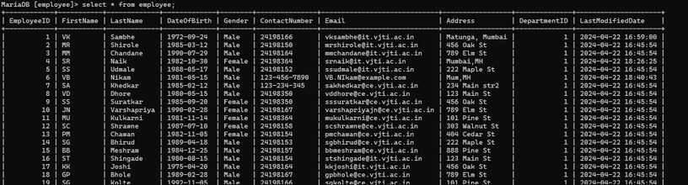
TRIGGERS
CREATE TRIGGER update_last_modified_date BEFORE UPDATE ON Employee FOR EACH ROW SET NEW.LastModifiedDate = NOW();
This trigger ensures that whenever any row in the Employee table is updated, the LastModifiedDate column for that row is automatically updated to reflect the time of the modification. This can be useful for tracking changes and maintaining data integrity.
Trigger in Database-
Result-

Slide 43
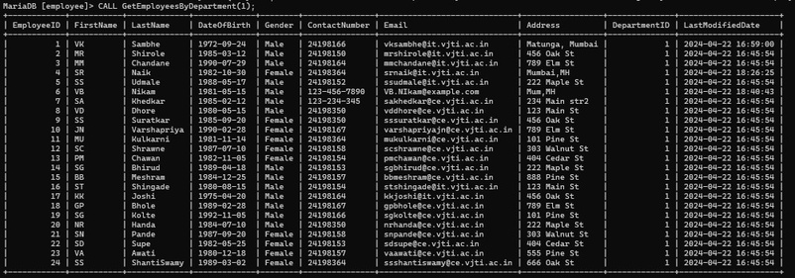
PROCEDURE
DELIMITER //
CREATE PROCEDURE GetEmployeesByDepartment(IN deptID INT) BEGIN
SELECT * FROM Employee WHERE DepartmentID = deptID;
END //
DELIMITER ;
This SQL script defines a stored procedure named GetEmployeesByDepartment that takes one input parameter deptID. The procedure selects all columns from the Employee table where the DepartmentID matches the provided input deptID.
Result-

Slide 44

DATABASE CONNECTIVITY, GUI & REPORTS
I .Designing Front end for Input Operations and Output Deliverables The front end of the system is designed using HTML/CSS with a node.JS backend to facilitate input operations and achieve the objectives stated in the revised problem statement. The graphical user interface (GUI) includes the following functionalities:

Slide 45
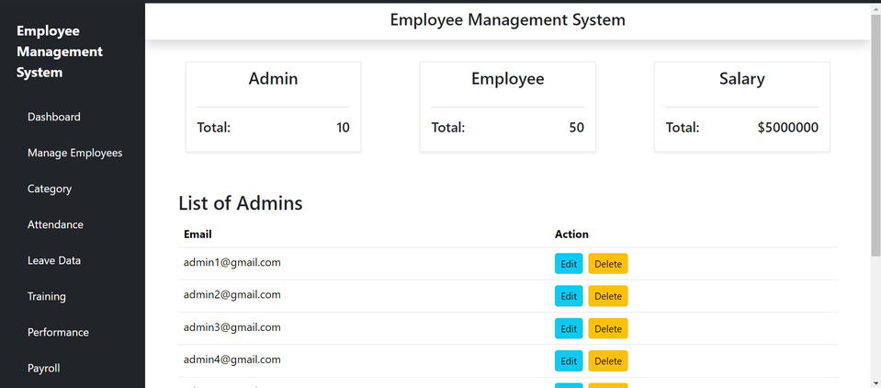
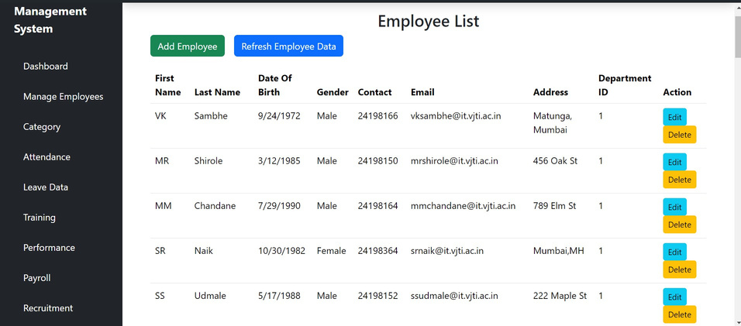

Slide 46
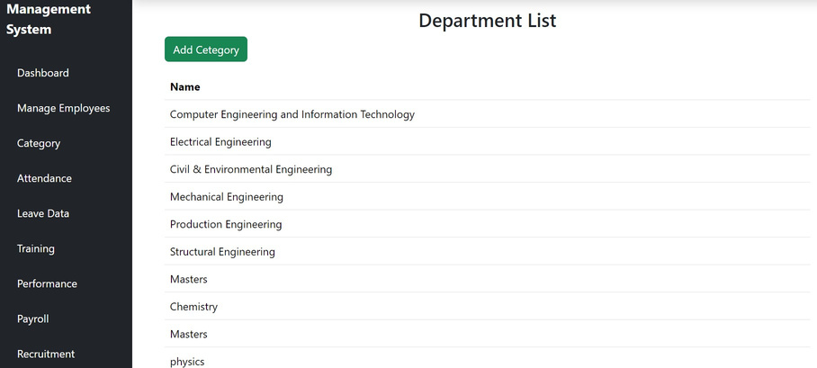
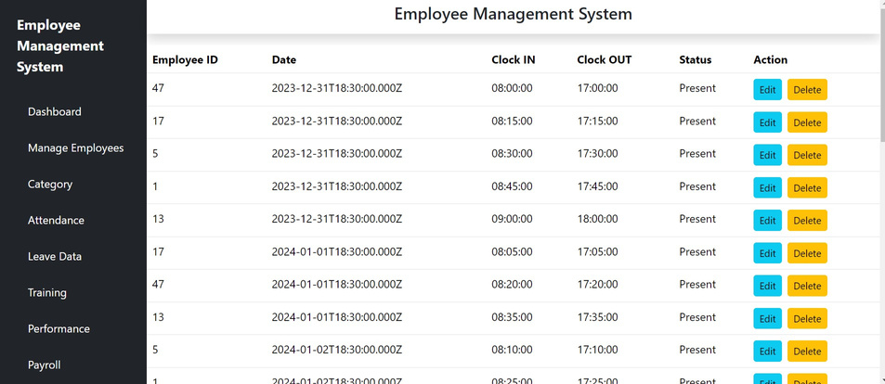

Slide 47
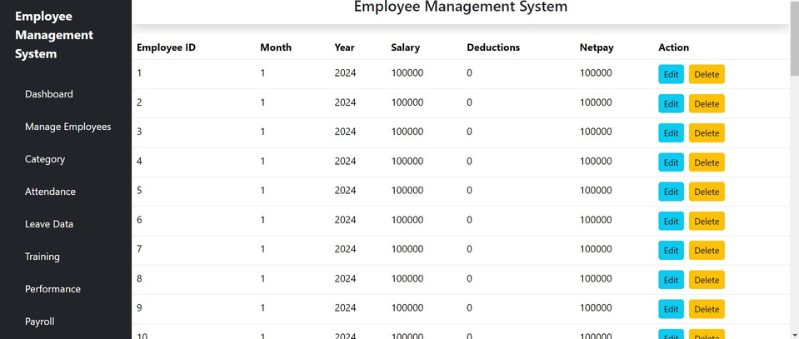
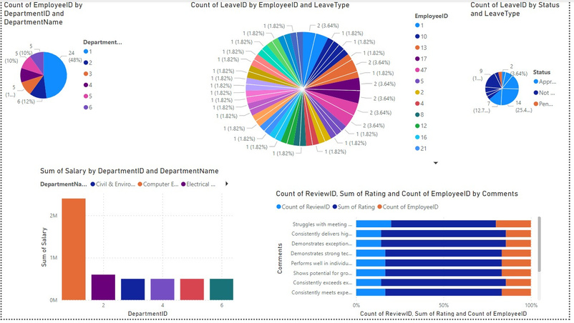
PowerBi-

Slide 48
REFERENCES
1. Basics of database : https://www.geeksforgeeks.org/what-is-database/?ref=lbp
2. SQL commands: https://www.geeksforgeeks.org/sql-ddl-dql-dml-dcl-tcl-commands/
3. Class and E-R diagram : https://www.javatpoint.com/uml-diagrams

